Slide 1
Chapter 2 Objectives
The CCNA Topics Covered in this chapter include:
  IPv4
  Classification of IP addresses
  Private IP addresses

Slide 2
IP Addressing
An IP address is a numeric identifier assigned to each machine on an IP network.
It designates the specific location of a device on the network.
IP addressing was designed to allow hosts on one network to communicate with a host on a different network regardless of the type of LANs the hosts are participating in.
IP Terminology
BIT - one digit -1 or 0.
BYTE – OCTET – 8 bits
Network address - This is the designation used in routing to send packets to a remote network—for example, 10.0.0.0, 172.16.0.0, and 192.168.10.0.
Broadcast address - The address used by applications and hosts to send information to all nodes on a network is called the broadcast address.

Slide 3
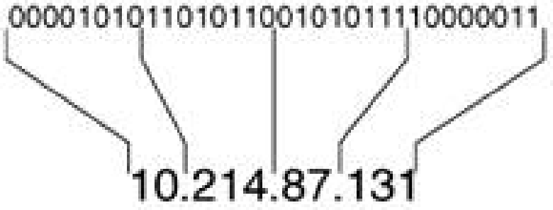
IPv4 Addresses
IPv4 addresses are 32 bits long
Have network portion and host portion
- Network portion uniquely identifies a physical or logical link
and is common to all devices attached to that link.
- Host portion uniquely identifies a particular device attached to the link.
IPv4 address can be represented in binary ( 32-bit ) and dotted-decimal ( 4-octets, each octet separated by “.”)
The dotted-decimal format is a convenient way to write IPv4 addresses, but it should not be confused with what the router (or host) sees: a 32-bit string.
The 32 bits of the address comprise four octets, each of which can be represented with a decimal number between 0 and 255, with dots between the decimal representations.

Slide 4
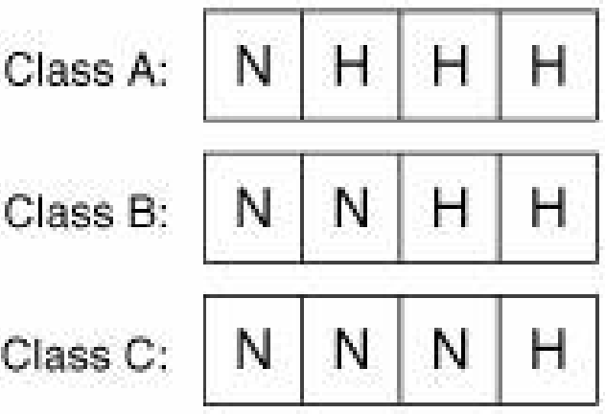
IPv4 Address Classification
IPv4 addresses are divided into different classes based on first octet rule
ABC …Easy as 1 2 3
Rule | Minimum and Maximum | Decimal range
Class A: First one bit is fixed i.e 0 | 00000000 = 0 01111111 = 127 | 1-126
Class B: First two bits are fixed i.e 10 | 10000000 = 128 10111111 = 191 | 128 - 191
Class C: First three bits are fixed i.e 110 | 11000000 = 192 11011111 = 223 | 192 - 223
Default masks for Class A, B, and C IPv4 addresses.
Class | Default Mask | Dotted Decimal
Class A | 11111111000000000000000000000000 | 255.0.0.0
Class B | 11111111111111110000000000000000 | 255.255.0.0
Class C | 11111111111111111111111100000000 | 255.255.255.0
The address mask is used to determine the network address.

Slide 5
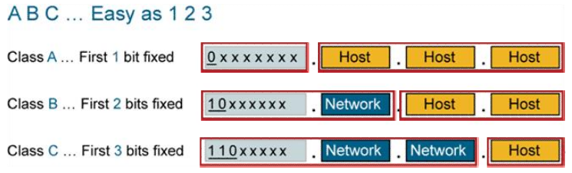

Slide 6
Private Addressing
Class Reserved Address Space
A 10.0.0.0 - 10.255.255.255
B 172.16.0.0 - 172.31.255.255
C 192.168.0.0 - 192.168.255.255
127.0.0.1 (Class A) Reserved for loopback tests and cannot be assigned to a network.
Public address – unique to be used in internet
Private address – Network with private address when connecting to public network
i.e internet, the private ip addresses must be translated to public ip address.
This translation process is called Network Address translation (NAT)

Slide 7
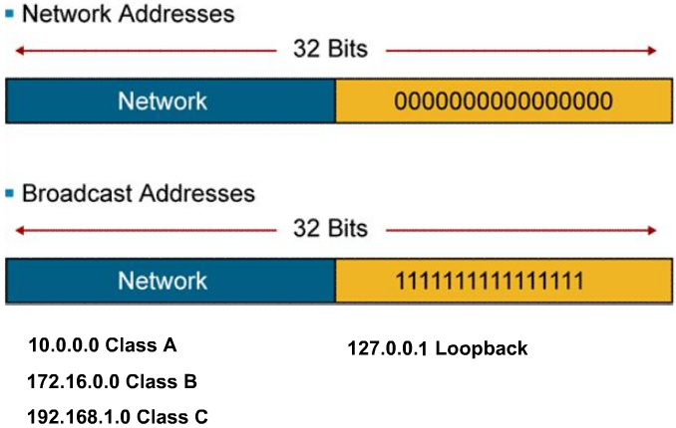
Reserved Address

